Slide 1



PREDRAG ANDREJEVIC MD,FACS, FRCSI
LET’S TALK ABOUT OBESITY
Notes:
Obesity is very common, affecting 1 in 6 adults and 1 in 11 children
Obesity has been described by the World Health Organisation as the largest health threat facing mankind. Obesity is manifestly an issue of energy balance.

Slide 2
Facts
Worldwide obesity has nearly tripled since 1975.
Obesity is very common, affecting 1 in 6 adults and 1 in 11 children.
In 2022, 2.5 billion adults aged 18 years and older were overweight.
Over 890 million adults were living with obesity. This corresponds to 43% of adults aged 18 years and over (43% of men and 44% of women) who were overweight.
Most of the world's population live in countries where overweight and obesity kills more people than underweight.
39 million children under the age of 5 were overweight or obese in 2020.
Over 390 million children and adolescents aged 5-19 were overweight or obese in 2022.
Notes:
Obesity has been described by the World Health Organisation as the largest health threat facing mankind. Obesity is manifestly an issue of energy balance. Yet, there is surprisingly little consensus about why such energy imbalance develops.

Slide 3
40.3% of US adults had obesity (defined as body mass index [BMI] 30
9.4% had severe obesity (BMI 40)
Projections showed that by 2030, almost half (48.9%) of US adults will have obesity and approximately 1 in 4 adults will have severe obesity.
Notes:
Obesity is a significant public health crisis worldwide and in the US. Based on reports from 2023.
severe obesity had doubled since 2000. 1,2

Slide 4
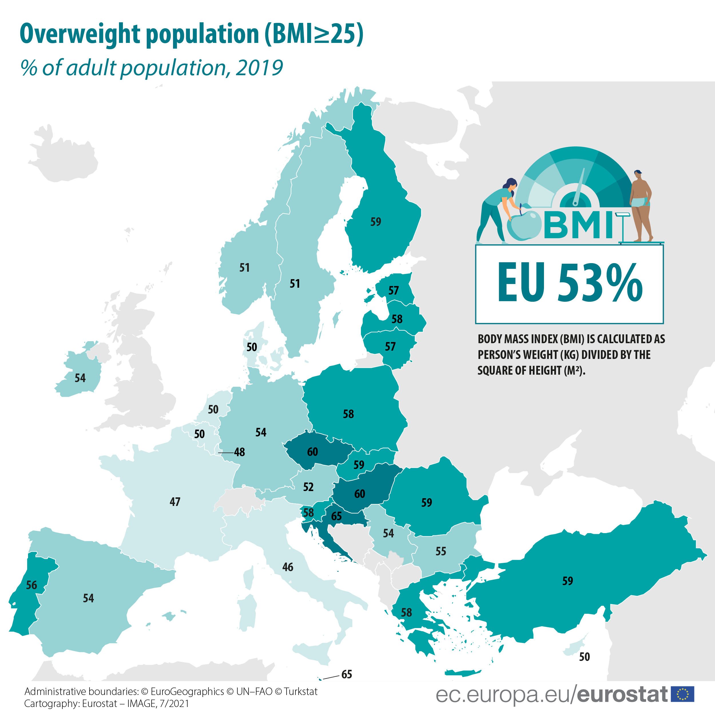
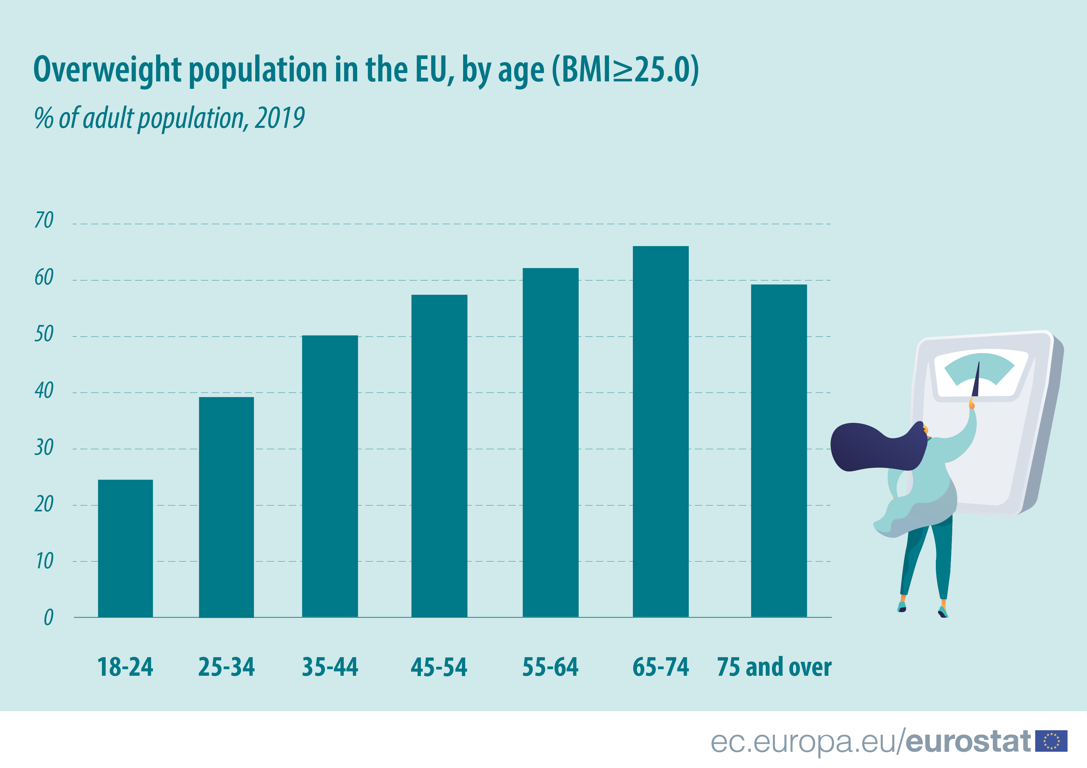

OBESITY IS PREVENTABLE.
Notes:
The proportion of overweight adults varies across the EU Member States, with the highest shares recorded in Croatia and Malta, where 65% of adults were considered overweight in 2019.
In contrast, the lowest shares were recorded in Italy (46%), France (47%) and Luxembourg (48%).

Slide 5
Definition
Overweight is a condition of excessive fat deposits
Obesity is chronic complex disease defined by excessive fat deposits that can impar health.
Type 2 diabetes
Heart disease
Affect bone health
Reproduction
Risk of certain cancers
Influences the quality of living, such as sleeping or moving
Notes:
Obesity is manifestly an issue of energy balance. Yet, there is surprisingly little consensus about why such energy imbalance develops.

Slide 6
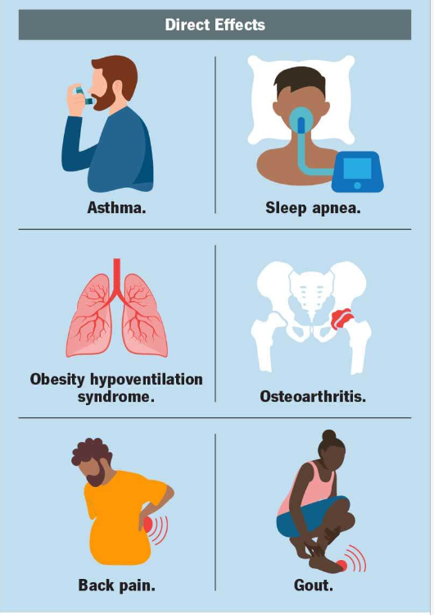
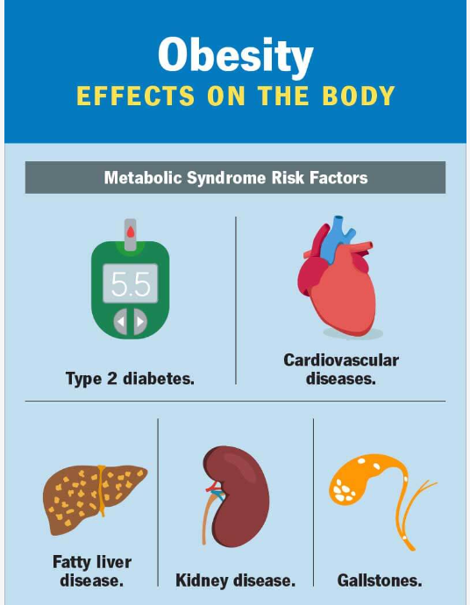
1 in 3 adults with obesity also has arthritis. Studies have shown that for every 5 kg in weight gain, your risk of knee arthritis increases by 36%.
weight loss of 10% can significantly reduce arthritis-related pain and improve your quality of life.
Obesity is also associated indirectly with:
Memory and cognition,
Alzheimer’s disease and dementia.
Female infertility and pregnancy complications.
Depression and mood disorders.
cancers, esophageal, pancreatic, colorectal, breast, uterine and ovarian.

Slide 7
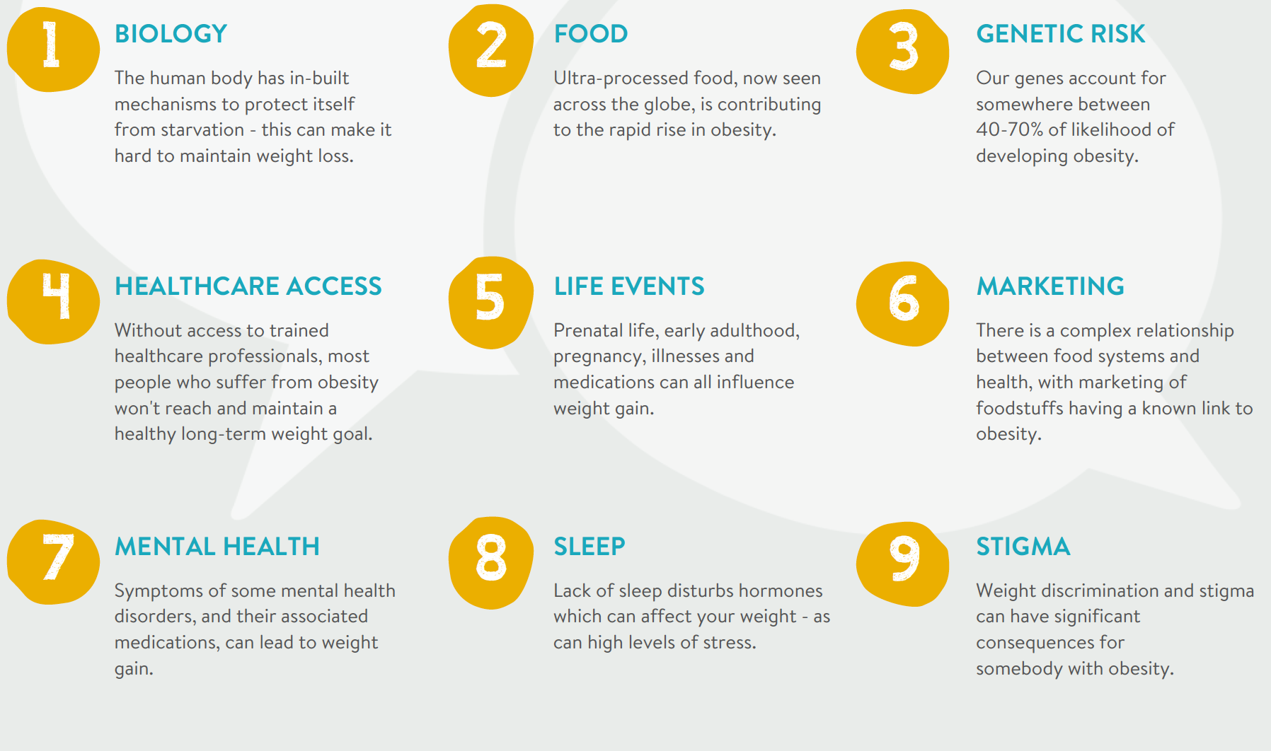
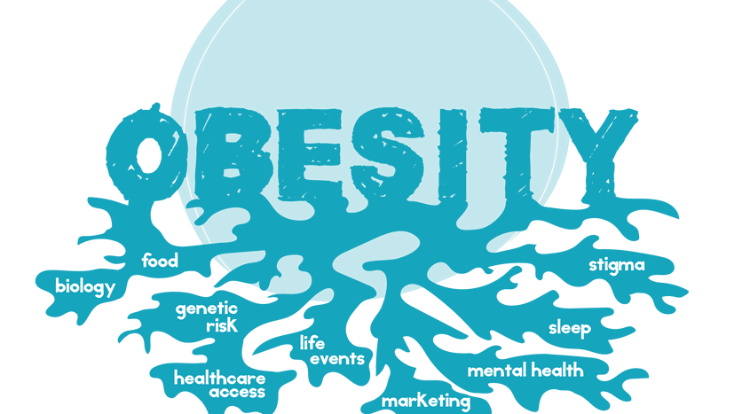

Slide 8
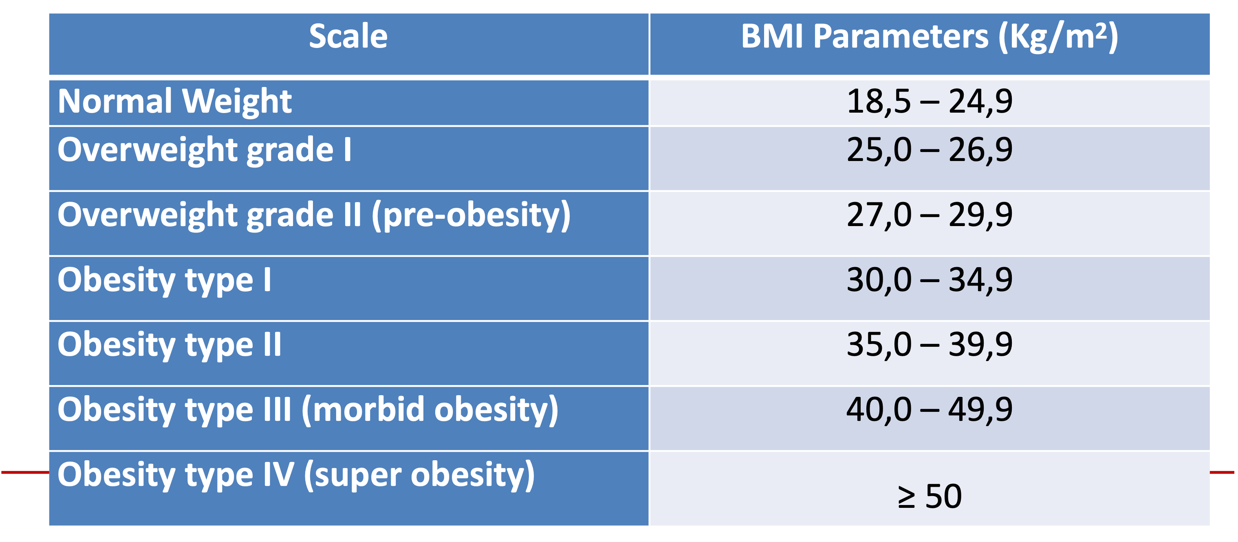
Definition
Children under the age of 5
overweight is weight-for-height greater than 2 standard deviations above WHO Child Growth Standards median
obesity is weight-for-height greater than 3 standard deviations above the WHO Child Growth Standards median
Children above between 5-19
overweight is BMI-for-age greater than 1 standard deviation above the WHO Growth Reference median
obesity is greater than 2 standard deviations above the WHO Growth Reference median.
The risk becomes significant when your waist size is more than 35 inches for people assigned female at birth or 40 inches for people assigned male at birth.

Slide 9
Childhood obesity
12.7% of children aged 2 to 5.
20.7% of children aged 6 to 11.
22.2% of adolescents aged 12 to 19.
Every child’s body and situation is unique
Some children are at a greater risk for weight gain than others
Obesity doesn’t develop from laziness or a lack of willpower.
Notes:
Childhood obesity is a complex condition that has many contributing factors.
Your child needs a certain amount of calories for growth and development. But when they take in more calories than they use, their body stores the extra calories as body fat (adipose tissue).

Slide 10
Which children are most likely to develop obesity
Children whose biological parents or siblings have obesity
Children, who experience adversity like:
  Racism
  Violence
Pre-pregnancy obesity of either or both biological parents.
Gestational diabetes.
Excessive weight gain in the birthing parent during pregnancy.
Notes:
Several factors also affect how much food we eat, the type of food we eat and how our body uses that energy. Every child’s body — and situation — is unique. Some children are at a greater risk for weight gain than others.
Obesity doesn’t develop from laziness or a lack of willpower.
Epigenetics is the study of how your behaviors and environment can affect the way your genes work. People, including children, who experience adversity — like racism or violence — can have changes in their genes that affect their immune system and metabolism. These changes can increase your child’s risk for having obesity due to how their body uses energy.

Slide 11
Family and home environment factors
The type of food parents and caregivers offer their children and how often.
Having sugar-sweetened beverages.
Eating larger portion sizes.
Increased snacking behaviour of highly processed foods.
Dining out instead of cooking meals at home.
Increased screen time.
Lack of physical activity (sedentary behaviour).
Lack of quality sleep.
Secondary smoke exposure
Adverse childhood experiences -ACEs
Notes:
Shared family behaviors and home environment factors can contribute to childhood obesity, including:

Slide 12
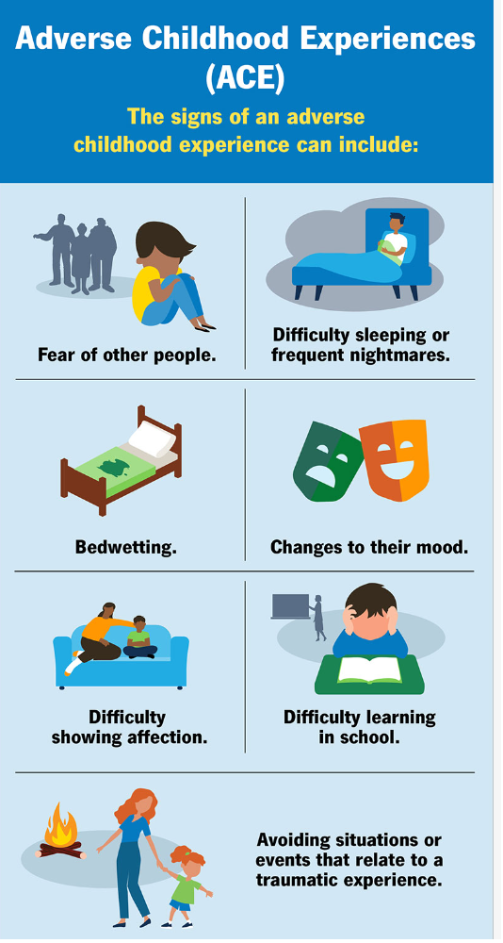
Girls
Racial or ethnic groups classified as a minority.
Children who experience socioeconomic challenges.
Children of parents or caregivers who experience stress.
Children who have family members or friends diagnosed with substance use disorder or a mental health condition.
Notes:
Any child under the age of 18 can have an adverse childhood experience. ACEs are more common among:

Slide 13
Child and obesity
High blood pressure or heart disease
Type-2 diabetes
Sleep apnea and other breathing problems
Abnormal or missed menstrual cycles
Bone and joint problems
Reduced balance
Low self-esteem and negative body image
Depression
Struggle with loneliness and friendships
Eating disorder
Notes:
Children with obesity may be susceptible to physical health problems such as:
Children living in larger bodies are at a higher risk of weight-related teasing and bullying which can have a negative impact on their mental health, leading to

Slide 14
Treatment at home-advise to parents
It usually starts with parents being aware of their own perception and attitudes about weight,
Avoid negative comments about a child or another person’s weight in front of their child.
The treatment a child receives at home will reflect how they react to weight stigma in the outside world.
No dieting or food policing
No fat shaming - all body types should be accepted and there should be an environment of love and care.
No scales
Body positivity
Embrace and love your child, no matter his or her body size and this should apply to siblings as they can be a source of shame and teasing
Notes:
in a language that is sensitive and appropriate.
That is why it is important to have a safe and secure environment free of fat shaming or trauma, and build confidence in the child.
Nobody at home should be on restrictive diets to lose weight – instead the focus should be on wholesome, real food that is nutritious and tastes good, with no restrictions or monitoring.
The focus should be on health and not numbers on a scale

Slide 15
Treatment
Nutrition therapy
Behavioural Intervention- parents and their children should be educated on making long-term healthy lifestyle choices and modify behaviours to improve eating habits, increasing physical activity, engaging in group activities and setting realistic weight management systems in place.
Physical Activity
For children and youth aged 5 to 17:
get at least 60 minutes of moderate-to- vigorous physical activity (MVPA) per day, on average.
get an additional several hours of light physical activity (LPA) through structured and unstructured activities.
Notes:
Pediatric obesity treatment is somewhat different from adults since parents are responsible for nutrition, physical activity and other lifestyle patterns for their child.
It is recommended to seek medical advice in case of any preexisting or underlying conditions that may be causing weight gain. The healthcare provider should be made aware of family history, any physical or mental trauma or any other risk factor for their child becoming overweight and together set up systems that are individualized, realistic and actionable.

Slide 16
Criteria for referral - adolescents
BMI ≥120% of the 95th percentile for age
BMI ≥35 (whichever lower)
plus a clinically significant obesity comorbidity or
BMI ≥140% of the 95th percentile for age
BMI ≥40 (whichever lower), with or without comorbidity.
Adolescent contraindications
: medically correctable obesity cause;
substance use disorder within prior year;
conditions preventing adherence or impairing decisional capacity;
current/planned pregnancy within 12–18 months;
inability of patient/guardian to understand risks/benefits.
Notes:
(examples listed: T2D, idiopathic intracranial hypertension, OSA with AHI >5, metabolic dysfunction‑associated steatohepatitis, Blount disease, slipped capital femoral epiphysis, GERD, hypertension, insulin resistance, reduced health‑related quality of life),
Common adolescent procedures sleeve gastrectomy now >80%; Roux‑en‑Y <20% (higher nutritional deficiency risk though may help T2D); both reduce weight/BMI in short‑to‑intermediate term (1–3 years).

Slide 17
Current options for treatment of obesity
Low Risk /
Efficacy
Low Risk
Diet / Drugs
Balloons
Low Efficacy
ESG/POSE
High Efficacy
Gastric
Sleeve
Gastric
Bypass
Unacceptable
Risk / Efficacy
High Risk
17
Notes:
Management of obesity involves lifestyle therapy pharmacotherapy and surgery. 2
comprehensive lifestyle intervention and pharmacotherapy are associated with approximately 5% total weight loss (%TWL) and 5% to 10% TWL, respectively. 3,4 In contradistinction, surgical intervention is effective and consistently induces greater than 25% TWL. 5 Nevertheless, less than 1% of eligible patients elect to undergo surgery. 6

Slide 18
TREATMANT CHOICE
- lifestyle therapy,
- obesity‑management medications (OMMs; e.g., GLP‑1 receptor agonists),
- endoscopic bariatric therapies (notably endoscopic sleeve gastroplasty, ESG), and
- metabolic/bariatric surgery (MBS).
In lower BMI classes, waiting until after medication discontinuation and subsequent weight regain is generally considered not preferred, because it can increase cumulative “disease burden

Slide 19
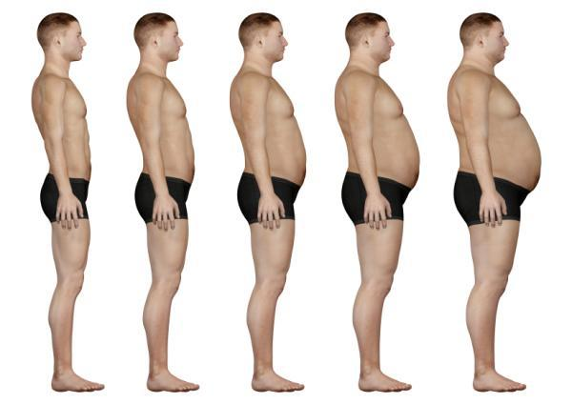

Bariatric Endoscopy
DIET
INTRAGASTRIC BALLOON
APOLLO/ESG
ENDOBARIER
SURGERY
BMI < 30
BMI > 40
Notes:
In the last years we are having more and more options for helping us to to fight against obesity in the endoscopic field, appearing more and more tools, devices, interest by medical companies.
We are experience the growth of a field that can help thousands of patients in the world.

Slide 20
The STEP (Semaglutide Treatment Effect in People With Obesity) trial reported that semaglutide, 2.4 mg, resulted in a mean 15.2% reduction in body weight over 2 years,
the SURMOUNT trials showed that tirzepatide, 10 mg, led to a 12.8% to 19.5% reduction in body weight and tirzepatide, 15 mg, led to a 14.7% to 20.9% reduction in body weight at 72 weeks.
Notes:
severe obesity had doubled since 2000. 1,2

Slide 21
TREATEMENT CONSIDERATION
Weight regain after stopping anti‑obesity medications is common: regain can begin as early as 8 weeks after discontinuation and may continue through 52 weeks; weight rebound often occurs within 1–3 years if treatment is not continued.
MBS is described as reaching cost neutrality within ~4–6 years via reduced obesity complications, while OMMs often require lifelong administration and are much less cost‑effective at current prices.

Slide 22
Practical escalation “triggers” for primary care → surgical referral
- Weight plateau: stable weight (±2 kg) for ≥8 consecutive weeks despite adherence to pharmacotherapy and lifestyle interventions.
- Suboptimal response to pharmacotherapy:
- <10% total body weight loss after 6 months on maximum tolerated dose,
- <15% after 12 months.
- Advanced obesity‑related complications (may warrant earlier surgical referral regardless of BMI):
- HbA1c >9% despite medical therapy
- Uncontrolled hypertension >160/100 mmHg on ≥3 medications
- Severe obstructive sleep apnea: AHI >30
- Established cardiovascular disease
- High‑risk individuals: ASA class ≥IV, severe cardiopulmonary disease compromising anesthetic safety, or other multidisciplinary contraindications.

Slide 23
How to choose among procedures
Willingness/ability to adhere to lifelong supplementation and monitoring is pivotal, especially for malabsorptive procedures.
via restriction, malabsorption, or both
Reversibility
Sleeve gastrectomy (SG)
RYGB, BPD‑DS, SADI‑S

Slide 24
What tends to make one option “best” for a given patient – BMI 30-34.9
ESG – ETWL – 20 %
Roux‑en‑Y gastric bypass (RYGB)
Expected weight loss- 65%–70% excess body weight
Weight loss typically levels off at 1–2 years; long‑term regain of up to ~10 kg
Sleeve gastrectomy (SG) -removal of 80% of stomach
Expected weight loss: about 60% or more of excess weight at 2 years.
Notes:
loss or co‑morbidity improvement using nonsurgical methods.
- Evidence grading: Level 2a, Grade B.
A separate adult-criteria summary is consistent that:
- T2D and BMI ≥30 → MBS is recommended, and
- BMI 30–34.9 → MBS should be considered if substantial/durable nonsurgical success is not achieved. [3
MBS is recommended for patients with type 2 diabetes (T2DM) and BMI 30–34.9.
- MBS is recommended for patients with BMI 30–34.9 and one obesity‑associated medical problem.
- MBS should be considered for patients with BMI 30–34.9 who do not achieve substantial or durable weight
Advantages: fast and dramatic weight loss; reliable/long‑lasting; effective remission of obesity‑related conditions.
Key risks/downsides: technically complex and difficult to reverse; higher vitamin/mineral deficiencies; small bowel complications/obstruction; dumping syndrome common; ulcer risk (especially with NSAIDs/tobacco); may increase risk of alcohol and psychiatric disorders.
Advantages: described as one of the safest options; often laparoscopic with faster healing; less nutrient malabsorption than bypass; can eat wider range of foods than some other procedures.
- Key risks/downsides: nonreversible; may worsen or cause new‑onset reflux (GERD); scar tissue may cause nausea/vomiting/trouble eating; cholelithiasis risk; long‑term vitamin deficiencies; less metabolic impact than bypass.

Slide 25
What outcome data exist specifically in BMI 30–34.9
Endoscopic sleeve gastroplasty (ESG) is highlighted as :
- less invasive and reversible
more durable than short‑term pharmacotherapy because its effects persist without ongoing medication,
- associated with benefits in metabolic parameters, patient satisfaction, and quality of life, T2DM remission 50%, DM relatied symtoms -70%
- usable when pharmacotherapy is not sustainable/appropriate, or as a bridge before considering MBS –ETWL-27%
RYGB, SG, one‑anastomosis gastric bypass
T2DM remission: 33–100%
Hypertension remission: 28–100%
Notes:
Studies show that ESG improves diabetes-related outcomes in approximately 50%–70% of treated patients, with significant reductions in Hemoglobin A1c (HbA1c), fasting blood glucose (FBG), and insulin resistance (HOMA-IR).
Combination Therapy: Combining ESG with GLP-1 receptor agonists (such as semaglutide) has been shown to boost weight loss up to 27% and further enhance glucose control

Slide 26
BMI 30–35 decision pattern
continue medical management with ongoing monitoring.
If persistent hyperglycemia and limited weight loss despite maximal pharmacotherapy → consider ESG as a minimally invasive bridge, or MBS if complications progress
Apply escalation triggers :
plateau ±2 kg ≥8 weeks;
<10% loss at 6 months or <15% at 12 months;
advanced complications such as HbA1c >9%, HTN >160/100 on ≥3 meds, AHI >30, established CVD
Notes:
If metabolic disease improves substantially on pharmacotherapy (e.g., diabetes remission) → continue medical management with ongoing monitoring

Slide 27
Proceeding to surgery at BMI 30–35: how to choose the operation
If prioritizing safety/technical simplicity and lower malnutrition risk: SG
If prioritizing fast, dramatic, durable weight loss and strong comorbidity effect: RYGB , OAGB
If prioritizing maximum weight loss/strongest diabetes effect (and accepting highest nutritional burden): BPD‑DS or SADIS
BMI > 35 – MBS
BMI 40–50 kg/m² (Class III obesity): prioritize timely MBS for acceptable-risk patients; short pre-op medical optimization for higher-risk patients – 3-6/12

Slide 28
What about the BMI >45
BMI ~45 with controlled diabetes/hypertension and acceptable surgical risk → proceed directly to MBS after brief optimization.
BMI ~48 with severe comorbidities/limited functional reserve → consider short pre‑op pharmacotherapy and optimization, then proceed to MBS.

Slide 29
Who a general practitioner (GP) should refer for surgical obesity treatment and how fast
BMI ≥35 kg/m² (Class II or higher) regardless of comorbidities,
- BMI 30–34.9 kg/m² with:
- T2DM, or
- another obesity‑associated medical problem,
- failure to achieve substantial/durable weight loss or comorbidity improvement with nonsurgical methods.
Fast
-Suboptimal pharmacotherapy response: <10% loss at 6 months or <15% at 12 months on maximum tolerated dose.
- Need to avoid delays that permit comorbidity progression .

Slide 30
Who should not be referred
- Pregnancy
- Inability to commit to lifestyle changes needed after surgery
- Cardiovascular, respiratory, or other medical conditions that make surgery dangerous
- Autoimmune connective tissue disease or a family history of one
- Active infection
- Uncontrolled inflammatory GI disease
- Anatomical abnormalities of the esophagus/stomach/intestines
- Certain bleeding disorders
- Prior gastric injury (from surgery or other causes)
- Active cancer
- Untreated or uncontrolled mental health issue, recent suicide attempt, or substance use disorder
ASA ≥IV

Slide 31
What the GP should do before referral and what to communicate
Document comprehensive lifestyle management attempts:
- dietary changes, increased physical activity, behavior modification (self‑monitoring, goal setting, stimulus control, relapse prevention).
- If pharmacotherapy was attempted (or considered), document medication eligibility thresholds used (e.g., BMI >30 or >27 with serious comorbidity) and response.
- Comorbidity screening/labs described:
- fasting lipid panel
- glucose/HbA1C screening for diabetes/prediabetes
- thyroid screening (e.g., TSH)
- liver function tests when indicated (e.g., concern for fatty liver/NASH)
- Screen for and address key contraindications (especially untreated psychiatric illness, recent suicide attempt, substance use disorder, and medical instability making surgery dangerous).
- Set expectations:
- bariatric surgery is major surgery with risks and requires permanent healthy dietary changes and regular follow up

Slide 32
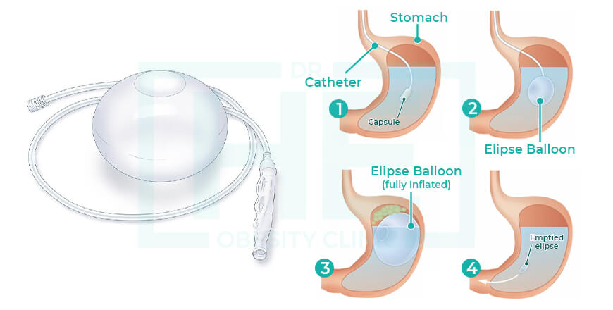
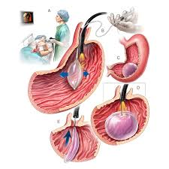
Intra gastric balloon

Slide 33
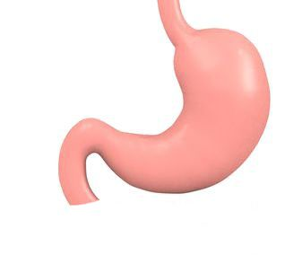
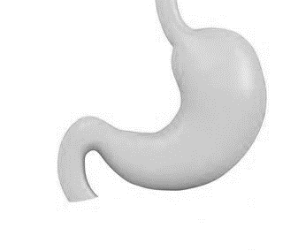
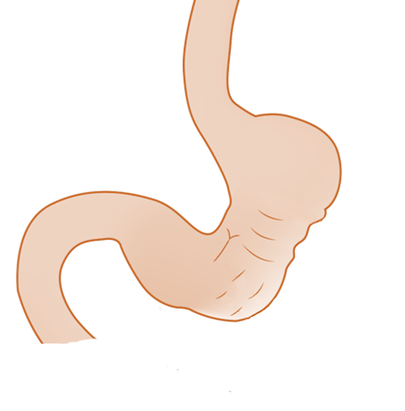
Creating a short and narrow Endoluminally Plicated Gastric Pouch
NARROWER
SHORTER
Notes:
This results in a distinctive and consistent much narrower and shorter stomach
AVERAGE OF 8 CM ( 6 TO 10 )

Slide 34
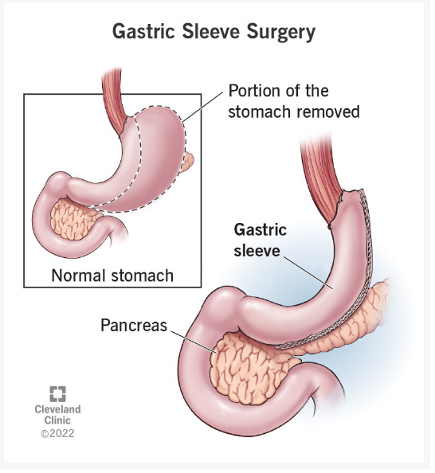
Surgical treatment of obesity
Insulin resistance and Type 2 diabetes.
Hypertension and hypertensive heart disease.
Hyperlipidemia (high cholesterol) and arterial disease.
Nonalcoholic fatty liver disease and steatohepatitis.
Obesity hypoventilation syndrome and obstructive sleep apnea.
Joint pain and osteoarthritis.

Slide 35
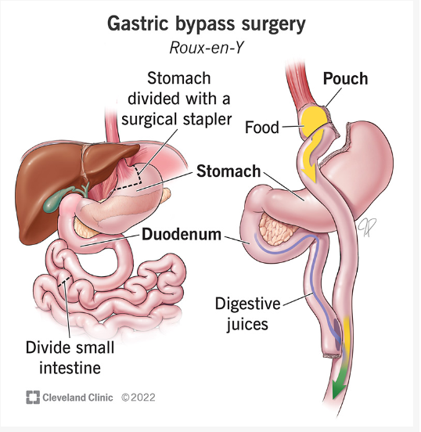
Surgical treatment of obesity
Have been diagnosed with class III obesity. This is determined by your BMI (body mass index). Class III obesity means a BMI of at least 40 kg/m2
Have a BMI of at least 35 with at least one obesity-related condition.
Have obesity-related type 2 diabetes. Because of its positive effects on blood sugar regulation, you may qualify for gastric bypass surgery to help manage your type 2 diabetes, if it’s unmanaged and you have a BMI of 30 or higher.

Slide 36
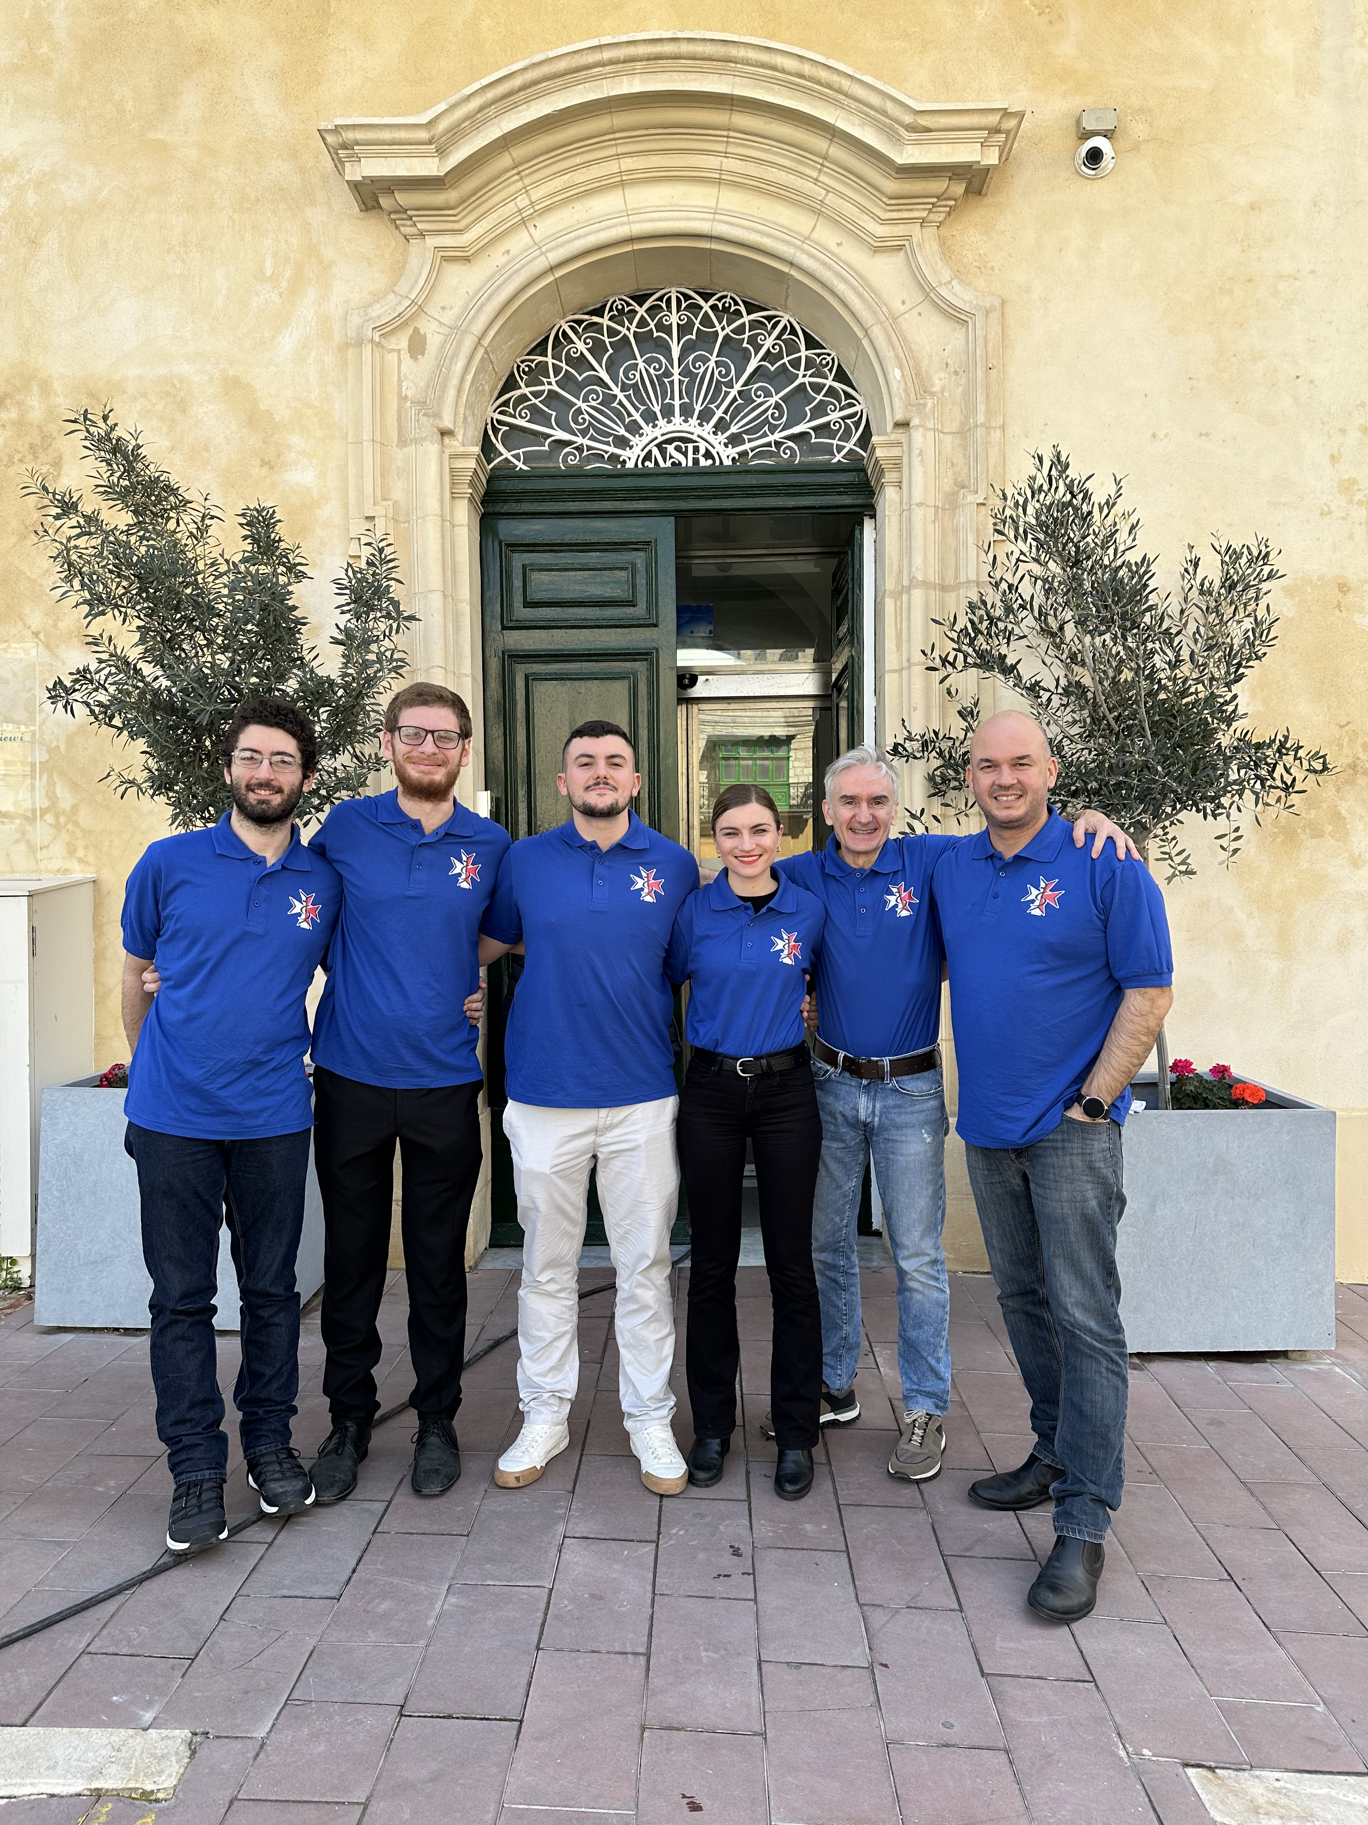

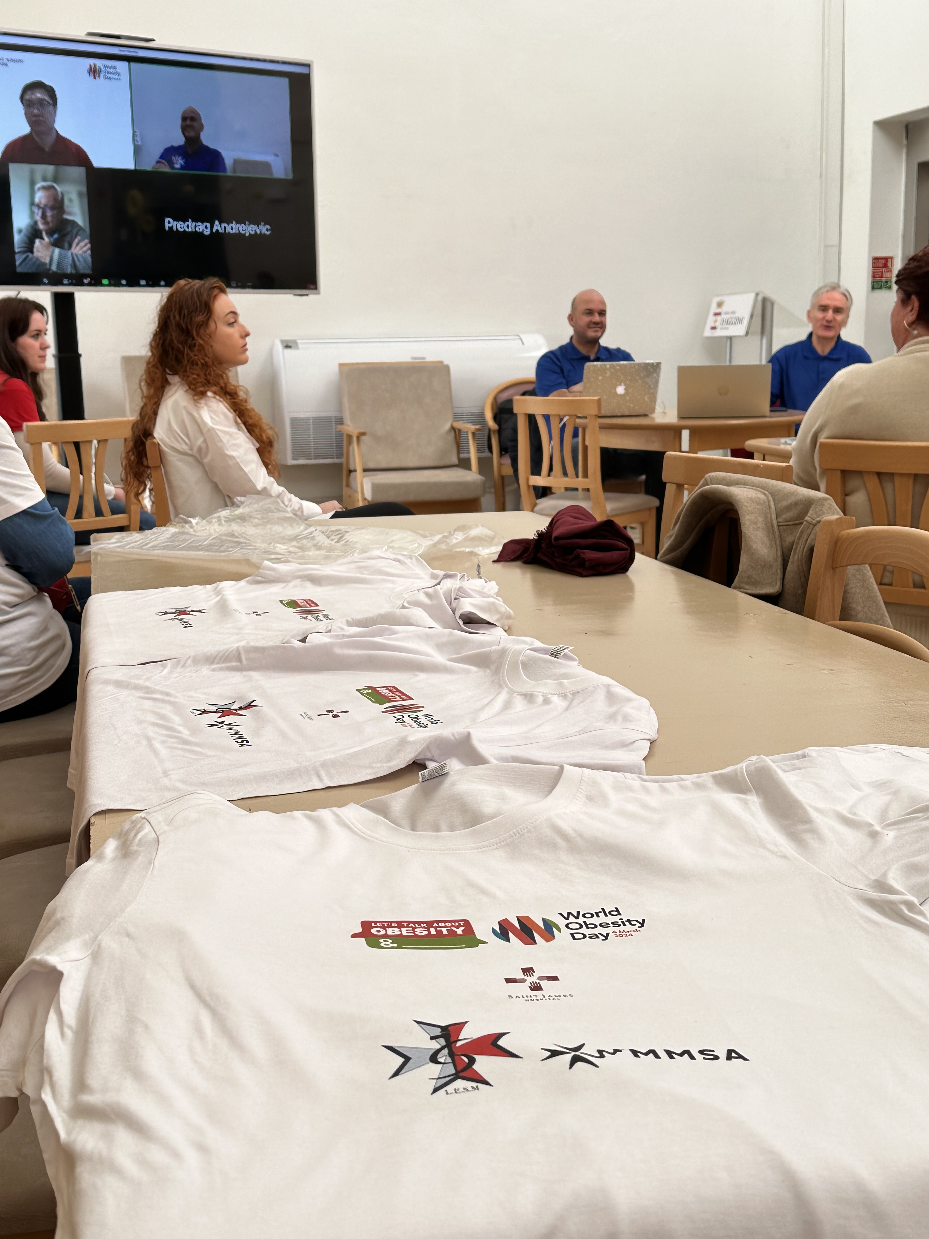


Slide 37

Thank you and,

Slide 38
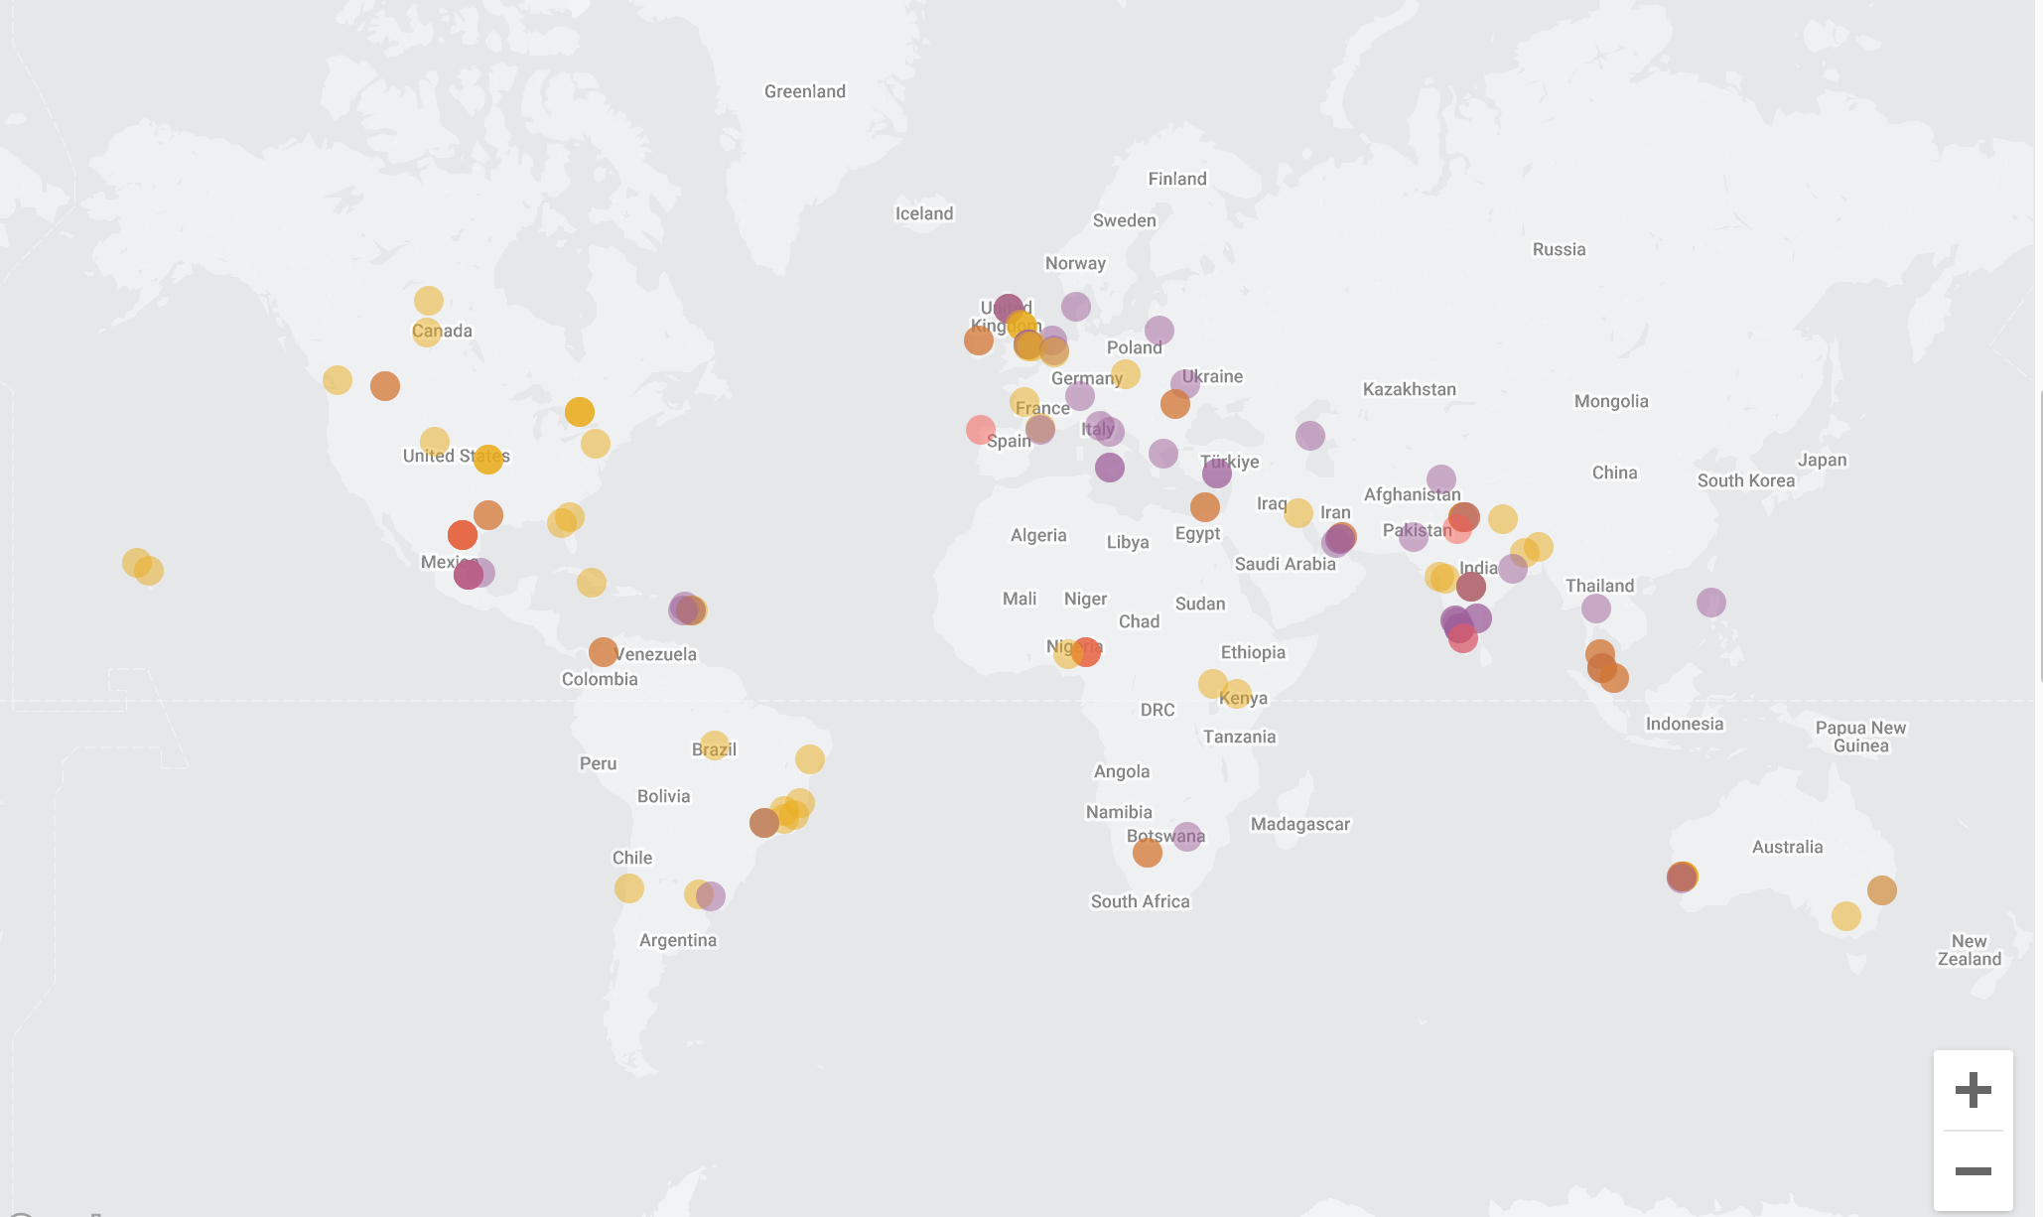
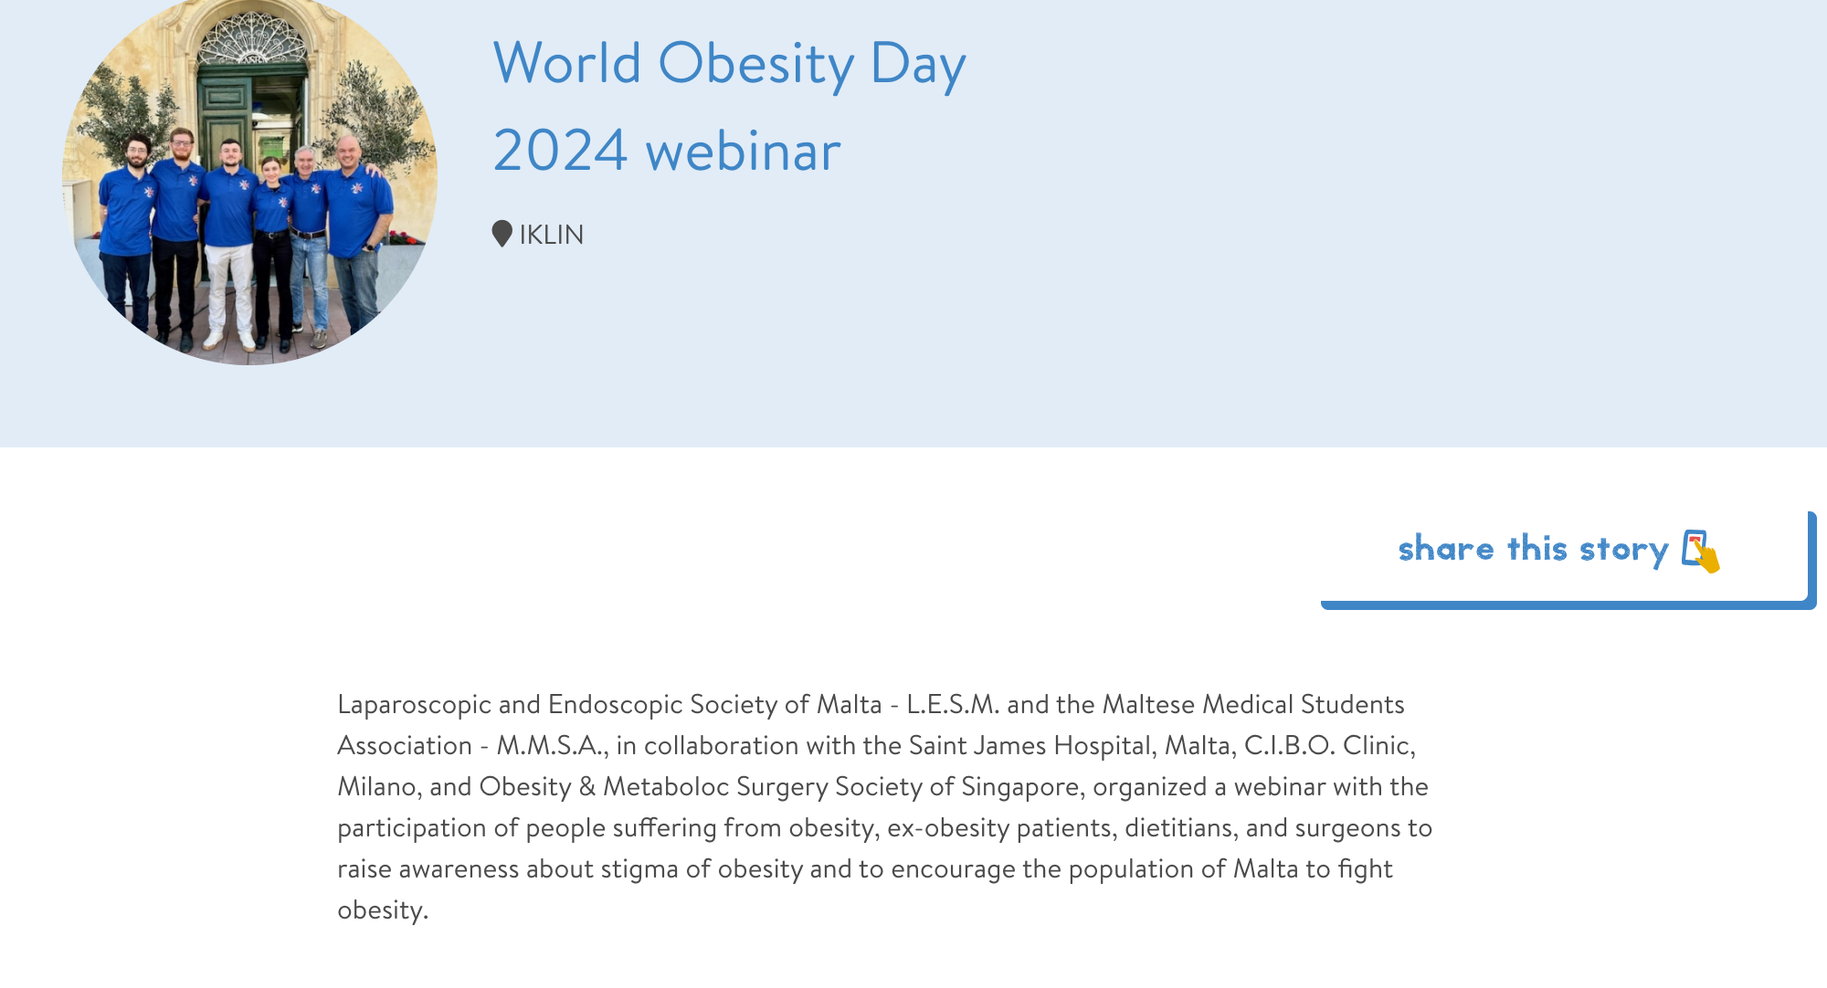
Conclusion
Shifting public health messaging away from obesity and towards healthy behaviours,
The use of public health policies that encourage the adoption of healthy behaviours, including for example nutrient-rich diets.
All people, including those with overweight and obesity, should be empowered and supported through structural interventions and policies
People living with obesity should receive positive representation in the media, including acceptance, inclusion, and empowerment.
Influencing governments polices for easier access to obesity medication, surgical therapy , nutritional and phycological services,
Rising awareness through social media and international campaigns.
Notes:
or alternatively away from behaviour completely, to allow the appropriate focus on the environments where the behaviour takes place
cooked from their raw ingredients (rather than ultra-processed foods), regular engagement in physical activity, and sleep sufficiency by intervening to create environmental drivers for these behaviours.
and positive public health messaging to adopt such healthy lifestyle activities and behaviours

